Slide 1
Lesson 7 - Special Selectors
Mr Mack 2019

Slide 2
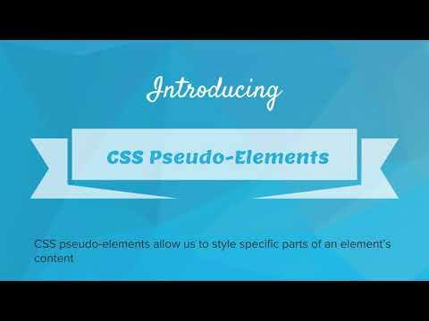
Special Selectors

Slide 3
Which of the following will turn the h1 tag blue as the mouse hovers over it?
hover > h1 {
color: blue;
}
h1:hover {
color: blue;
}
h1; hover {
color: blue;
}
h1, hover {
color: blue;
}

Slide 4
Example: Vote For Me
Here is a ballot webpage. The name you hover over will be highlighted

Slide 5
Example: Vote For Me Pt 2
Here is a more aggressive ballot. When you hover over the names, it tells you pick that person. When you click on a name, it thanks you for choosing that person.

Slide 6
Exercise 4.7.1: Extend Vote For Me
This is the code from the example you just explored. So far, two candidates have been eliminated. It’s time to ramp up the campaign!
Your task is to modify this code so that each name has a unique message when you hover over the name. Make sure to make use of the IDs to create the rules.
Then, modify the code so that each name has a unique thank you message when you click on it.

Slide 7

Exercise 4.7.2: Special Vendors
You’ve seen several examples of special selectors. You can find a complete list here: https://www.w3schools.com/CSSref/css_selectors.asp
For this exercise, you will use the :first-child selector.
Your Task
Add a CSS rule that selects the first li element that is the first-child. This will select the first item in each of the ul lists on the page.
Make the first item in each list have the font color #32ed96 and the font size 24px.
Use the :first-child selector. This selector picks the element tag that is the first child of another element. For instance, p:first-child selects all of the <p> tags that come first inside of another tag.

Slide 8
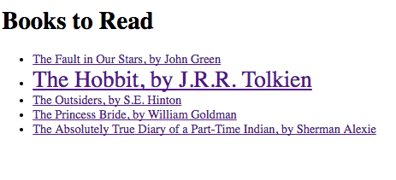
Exercise 4.7.3: Checklist
Create a webpage that has a list of links to books that you want to read, or think others should read. You should link to the book’s Wikipedia page.
Then create a CSS rule that increases the font size of the link to 30px when you hover over the link, like this:

Slide 9
Exercise 4.7.4: Career Website: Add Milestones
Copy your HTML code from the previous Career Profile website exercise
It’s time to expand your website!
We’re going to add a new page to the site named milestones.html. This page will contain a checklist of steps to take to get the job that you want.

